Slide 1

Importance of Business Communication
By:-
Soumik Chakraborty
M.Tech (GIS)
Neemrana, Rajasthan

Slide 2
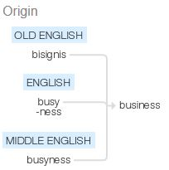
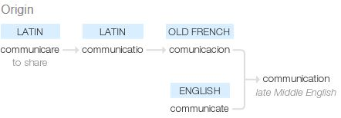
Business Communication- Origin & Entomology
Old English bisignis ‘anxiety’ (see busy, -ness); the sense ‘state of being busy’ was used from Middle English down to the 18th century, but is now differentiated as busyness . The meaning of this word eventually evolved to “occupation” and then “trade”.
Communis is noun word, which means ‘common, communiality or sharing’. Communicare is a verb, which means 'make something common'. Some scholars relate the term communication with an English word community. Community members have something common to each other.

Slide 3
Communication in Context of Business
What & Why?
“Communication is a continuing and thinking process dealing with the transmission and interchange with understanding of ideas, facts and courses of action.” George R. Terry
Business communication is the process of sharing information between people within and outside a company.
Examples:- Managers need to communicate with supervisors who need to communicate with their teams. Colleagues need to communicate with each other. Hiring of trained third party companies to smoothen up the Hiring and Firing of employees etc.
Effective business communication is how employees and management interact to reach organizational goals. Its purpose is to improve organizational practices and reduce errors.
The importance of business communication also lies in:- Presenting options/new business ideas, making plans and proposals (business writing), executing decisions, reaching agreements, sending and fulfilling orders, successful selling, effective meetings

Slide 4


HOW Business Communication? depends on the functions performed by communication. These functions are as follows
1. Provide and receive information
2. Collect and sift information
using external and internal sources
through different medium
through different media
How?
By Continual Education Process and Updating Knowledge through-
Seminars
Conferences
Refresher Courses
Workshops
Advertisements, articles, informative talks, etc. outside the organization
Results- Decision Making after identifying, analyzing and evaluating

Slide 5
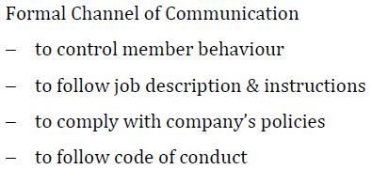

Controlling Factors of Business Communication:
Results: Discipline, uniformity and systematic behaviour

Slide 6
Key Ingredient for Business Communication?
(Motivation)
What?
All business is goal oriented, to achieve target within a framework of time by Robins . best of the workers → motivated workers
To Motivate is to Teach how to move towards success and to motivate the instructor who should be willing to teach the workers- “Actions speak louder than the Words.” Persuasion (Mrs.Urmila Rai)
Why?
How?
Concept of Reward and Punishment
Reward/ Incentives more effective and productive
Cash Reward → Happy → encouraged → Success
Positive Attitude, Emphatic Listening, Encouragement- rewards (cash, holiday trips (abroad), holiday resorts, furnishing allowances, quick promotion)
Motivation to earn perks, bonus, holiday package
Value and image of the organization
Efficiency and healthy work environment

Slide 7
EMOTIONAL EXPRESSION & INTERDEPENDENCE

